Slide 1
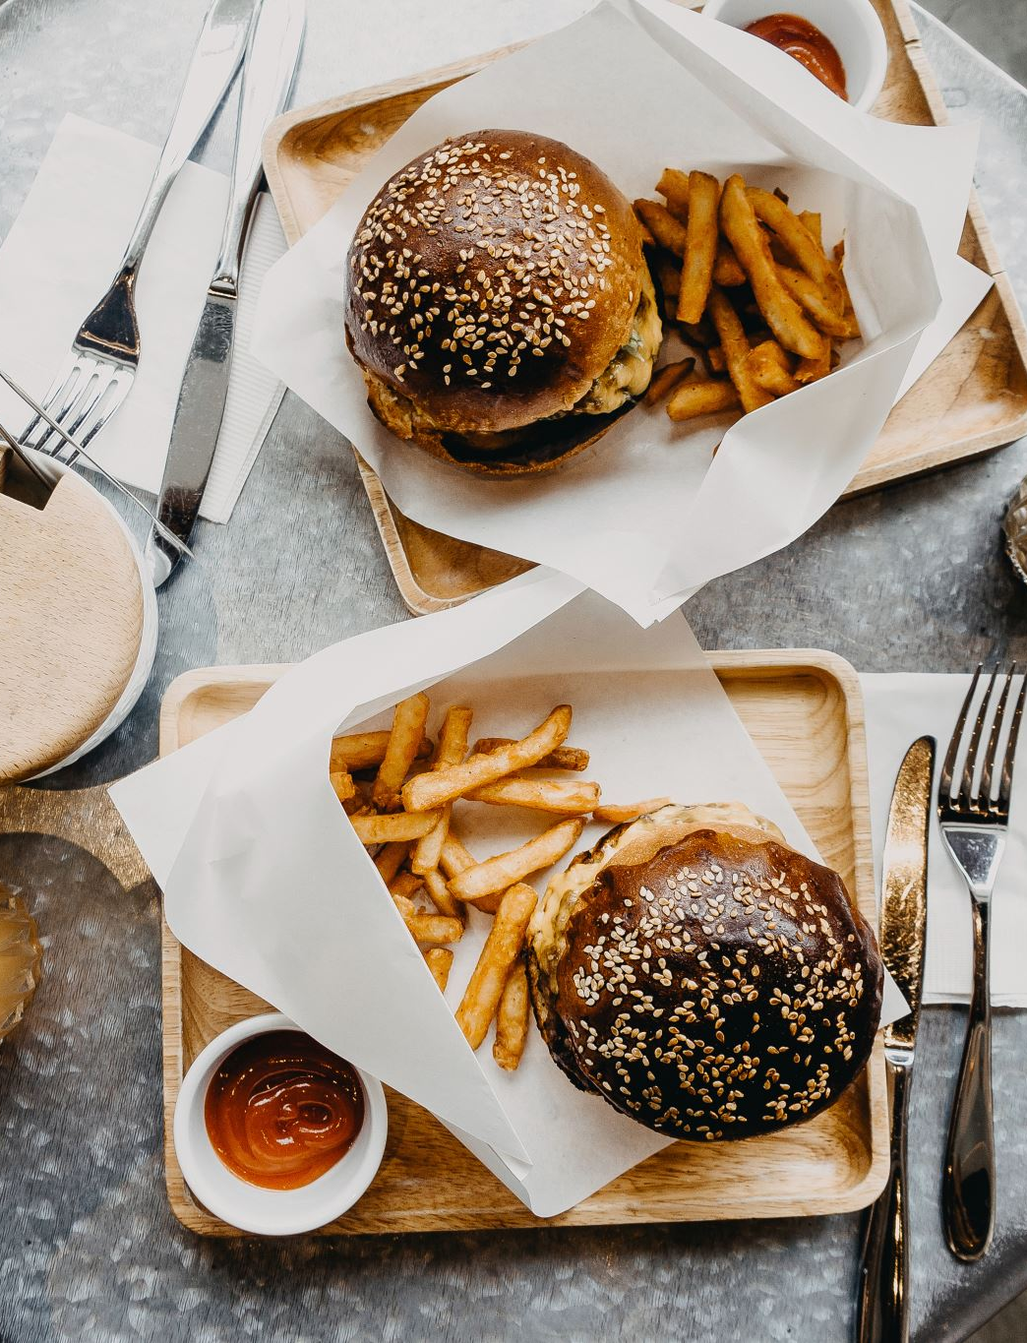

Fast Food Data
By Zafer Zaarour
Data Engineer

Slide 2

Goal?
Complete a project using AWS
Complete a project using a correct pipeline on cloud
Provide useful insight from the project outcome

Slide 3
Pipeline
Capture: Dataset, API etc
Ingestion: Eventbridge, Cloudwatch, Lambda, S3 Bucket
Processing: Python, Pearl, etc
Load: Glue Crawler, Glue Data catalog, Athena
Use: QuickSight

Slide 4

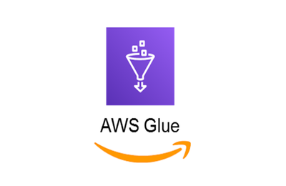






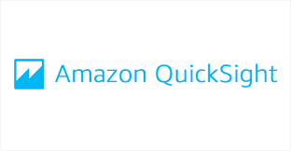
Pipeline Graph
CloudWatch
Capture
Ingestion
Processing
Load
Lambda
Use

Slide 5
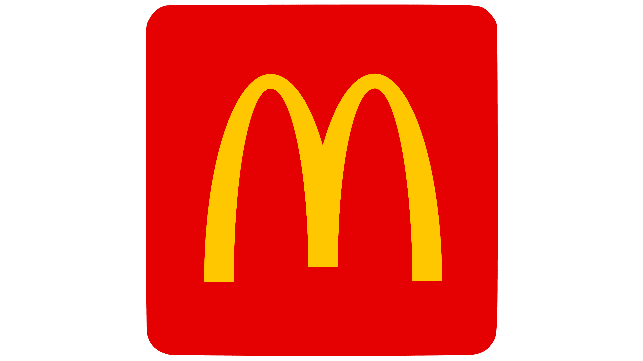
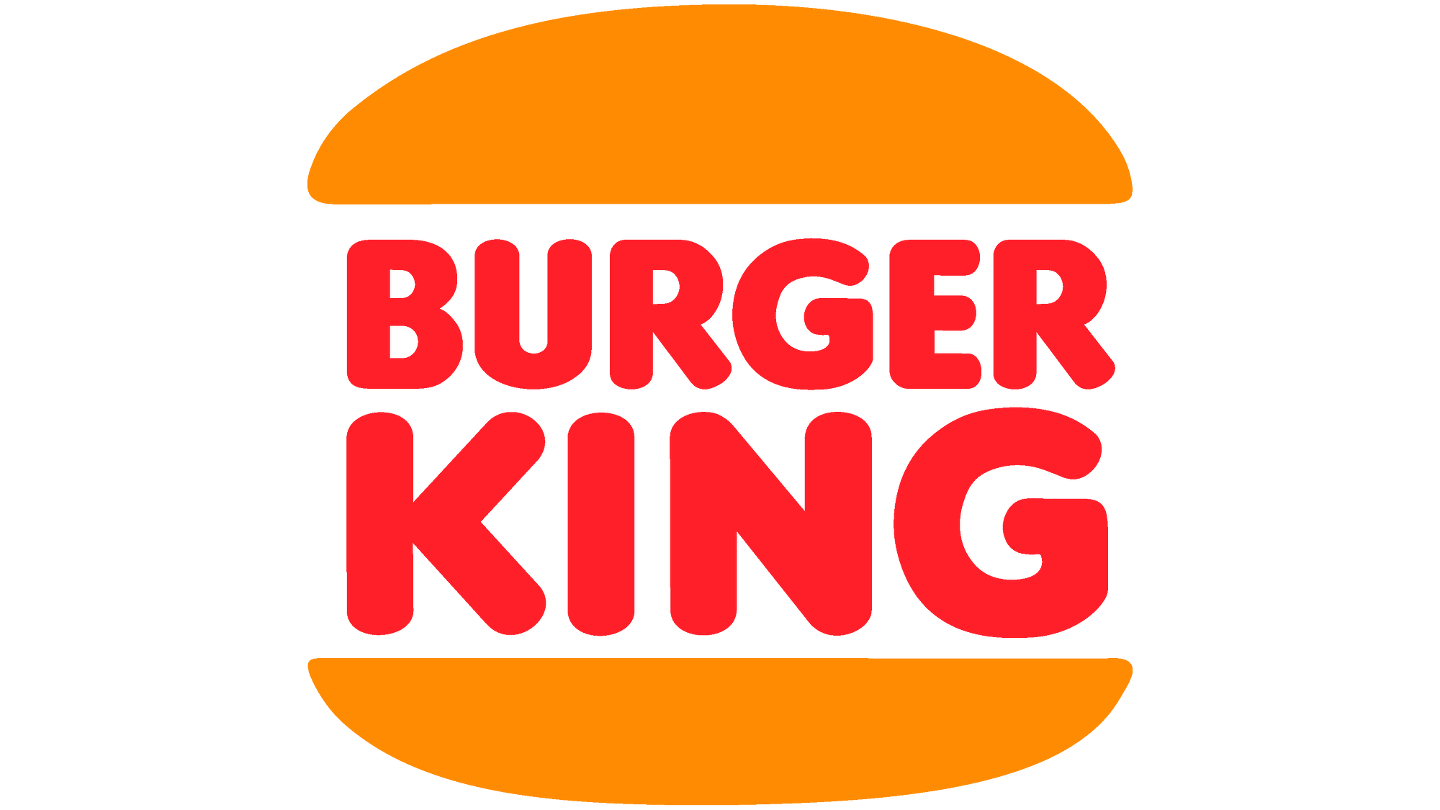
Data Sources
Initially uploaded a .csv file directly to S3 bucket
Could use API as an alternative
Contains nutritional information from the biggest fast-food chains in the world

Slide 6
What are the benefits?
Customers are able to make more informed decisions when deciding which chain to visit
Able to compare similar food items
Caters for customers with health conditions
Improves health of customers, at the expense of business sales
Tailored towards the customer rather than the business

Slide 7
Ways to Improve the project
Use a more compendious API/Larger Dataset
Expand the data to a wider range of fast-food chains
Implement real-time streaming, however this doesn’t apply to this use case
Could tailor the outcome for people with specific dietary or health conditions, e.g. vegetarian, vegan, diabetes, high cholesterol.

Slide 8
Thank you

